Slide 1


The android project

Slide 2

ABOUT
Rick and Morty API project is designed with an iterative approach that will allow us to learn and continuously improve our skills in Android app development. As we progress, we are committed to exploring and adopting best practices in programming and architecture, ensuring that our code is maintainable, scalable, and efficient. Each iteration will provide us with the opportunity to apply new knowledge, rectify errors, and hone our technical skills, thereby creating a solid foundation for high-quality mobile app development.

Slide 3

Put your S*** together
You’ll need a GitHub account. Once you have it configured in your laptop, download the project from here and set it up in your Android Studio.
Once you are able to execute the app and see it in your emulator/device, you can go to the next step.

Slide 4

Your turn - Step 1
Let’s start with something simple. Create a button and a text. Once the button is pressed, the text should change and show another message. Try to not copy-paste from internet, we want to know what your level is and then progress from there.

Slide 5

Step 2 – network call
Nice done. Let’s go with something more complex. Now we’ll connect our app with THE INTERNET. To do that, you’ll need to add an external dependency, as the project doesn’t have a way to do network calls by default. I strongly suggest to use Retrofit (actually, it’s not a suggestion, use it).
Your task is to connect the app to the Rick & Morty API and retrieve all the characters. Now, when the button is pressed, a call to the /characters endpoint should be triggered and the json response should be shown in the text view that we added in the previous step.

Slide 6

Step 3 – parsing
So, you are painting a bunch of non-sense words in the screen, let’s do something more visual.
Create an object to retrieve the response with a nested object for read the characters values. You only need to parse the Name, the image and the status.
Show the first character to the users.

Slide 7

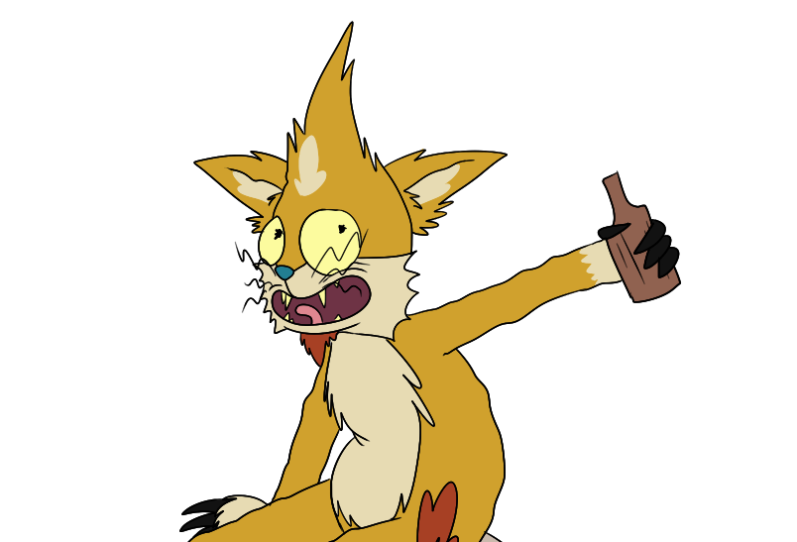
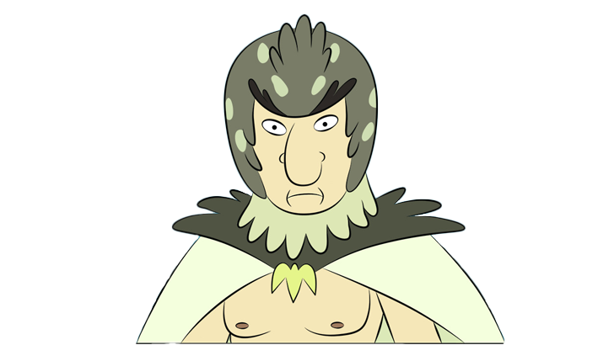

Step 4 – show all characters
Rick is not the only one! Show them all using a recyclerview and an adapter.
Hide the button if the character list is retrieved successfully.

Slide 8

Step 5 – the details
Create a new screen to show the character details and navigate to it when a character is pressed.
Show some extra information obtained from the API. I let you be creative, but the origin and the location should be presented.

Slide 9

Step 6 – adding filters
There are too many characters with unknown status.
Create a filter in the main screen to split the list between alive, dead, unknown and all.
Furthermore, we don’t need that button to do the request, make it automatically when the screen is presented.

Slide 10

Step 7 – architecture
Seems that MainActivity starts to have too many lines, let’s start with architectural stuff. First, you need to create a MainViewModel. This class will contain all the logic needed to make the MainActivity work. From now on, the activities should be as dumb as possible, avoiding ifs and logic there.

Slide 11

Step 8 – More details
Let’s go for something else.
Now you need to show the date where each character appeared for first time in the show, also the episode.
For example: in Rick’s detail page, you need to show “S01E01” and “December 2, 2013”

Slide 12

Step 9 – Threads
Seems that there are some activities handling the threads… but we said that activities should be dumb. Let’s move that thread handling to the viewmodels.
Use withContext to achieve that.

Slide 13

Step 10 – Repository
Now we are duplicating the API things, it’s moment to create a new architectural layer.
We call it repository, will be on charge of obtaining the data.
Create the RickAndMortyRepository and manage from them the calls to the backend.

Slide 14

Step 11 – database
Now that we have everything ordered, let’s allow the user to use the app offline.
To achieve this, store the characters in the database using Room.
Don’t forget to handle the no internet scenario on the details!

Slide 15

Step 12 – A new api
Sometimes, you don’t have all the information you need in your API and you’ll need to integrate many sources in your app. Let’s include the Episode rating. To achieve this, connect with the TMDB API.
Go to the repo tag: 12a-apikey.
Add your apikey to the local.properties file: tmdb_api_key
You’ll be able to access to the Apikey using BuildConfig.TMDB_API_KEY
The series_id for Rick & Morty is 60625. Show in the details the episode rating and the image for that episode. Use https://image.tmdb.org/t/p/w500 as base url for the image.

Slide 16

Step 13 – usecases
After adding a new API seems that the ViewModel is a bit messy.
Let’s add a new architectural layer. The usecases helps you to combine information coming from different repositories, also the logic is moved out of the ViewModel, allowing you to reuse that use case from another place in the app.

Slide 17






Step 14 - test
Seems that you are building a big app, but is it robust enough?
You need to test your functionalities to ensure you don’t break anything!
Each layer should have their own unit tests.
Rick Sanchez
Diane
Beth Smith
Jerry Smith
Summer Smith
Morty Smith

Slide 18

Step 15 – Mark as fav
Let’s apply everything together. Create a new feature requires use all your knowledge to make it work properly. In the Character details, add a way to add/remove it from favs list. This fav list will be show as one of the filters in the main screen.

Slide 19
Thank you

